Slide 1
Sketch Camera Using OpenCV
Submitted to:
Dr. Geeta Kasana
Submitted by:
Arshiya Kishore
102103565

Slide 2
Methodology
Objective: Creating a live sketching application using OpenCV.
Setup: Install Python and OpenCV.
Sketching Function: A function to process frames into sketches.
Initialize Capture: Use ‘VideoCapture’ to access the camera.
Handle Input: User interaction (exit with ESC, save with ENTER).

Slide 3
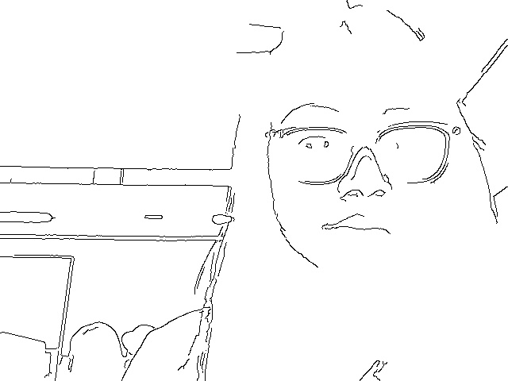
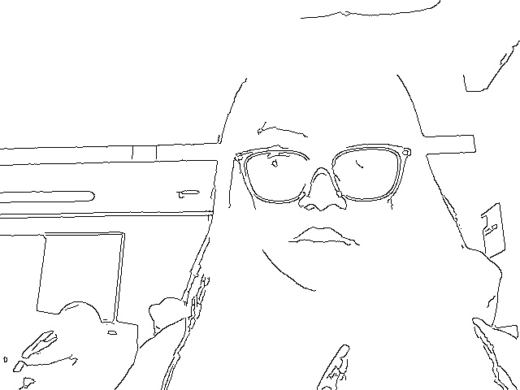
Example Output

